Slide 1
Agriculture supply chain management using blockchain
Team number: 8 Guide: n.anil Kumar
D.Lakshmi bhavani (1602-20-737-141)
Y. Sai Neha (1602-20-737-158)

Slide 2
AGENDA
PROBLEM STATEMENT
ABSTRACT
PROPOSED MODEL
OUTPUT
FUTURE SCOPE

Slide 3
PROBLEM STATEMENT
To Create a robust blockchain system to track agricultural products from start to finish, ensuring complete traceability. Integrate smart contracts into the supply chain to automate transactions, promoting transparency and fairness among stakeholders. Establish a decentralized data management system to maintain consistent and accurate information across the entire supply chain. Additionally, implement anti-fraud measures within the blockchain framework to protect the integrity of the supply chain, preventing fraudulent activities and ensuring the authenticity of agricultural products. This comprehensive approach aims to revolutionize the agricultural supply chain by leveraging blockchain technology for increased transparency, efficiency, and trust.

Slide 4
ABSTRACT
This project proposes the development of blockchain-based application designed to revolutionize the agricultural supply chain. The platform facilitates seamless registration for farmers, distributors, and sellers, creating an interconnected network. Farmers contribute vital product details such as quantity, price, and production information. Distributors express interest by sending purchase requests, leading to transparent visibility of products and their origins. The blockchain ensures immutability and security of these transactions. Sellers, equipped with comprehensive information, make informed purchases, subsequently updating the product status to 'sold.' This approach not only enhances traceability but also increases efficiency and reliability in agricultural commerce.

Slide 5
Proposed model
Supply chain
network
Smart contract
Distributor
orders
Distributor
Farmer
products
seller
Seller
Order

Slide 6
This project proposes the development of a blockchain-based solution leveraging Solidity, Ethereum, and Ganache to address critical challenges in agriculture supply chain management.
The implementation utilizes Solidity, a programming language for smart contracts, to create a secure and automated system ensuring end-to-end traceability of agricultural products.
Ethereum, as the underlying blockchain platform, provides a decentralized network for transparent and efficient transactions, fostering trust among stakeholders. Ganache serves as the testing and development environment, ensuring a smooth and reliable deployment of the blockchain solution.
The advantages of this integrated approach include immutable traceability, facilitated by Solidity's smart contracts, transparency and decentralization offered by the Ethereum blockchain, and a robust testing environment provided by Ganache.

Slide 7
execution Of smart contracts
Remix is an online IDE for writing, compiling, and deploying smart contracts. Supports various blockchain environments, making it versatile for Ethereum development.
Code is compiled using the Solidity Compiler in Remix
Deploy the compiled smart contract to the Ethereum blockchain
After deployment, interact with functions in the deployed contract.
Confirm transactions in Remix .

Slide 8
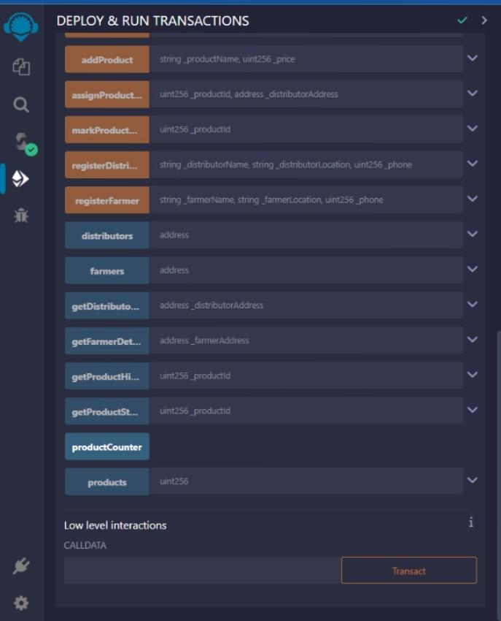
OUTPUT

Slide 9
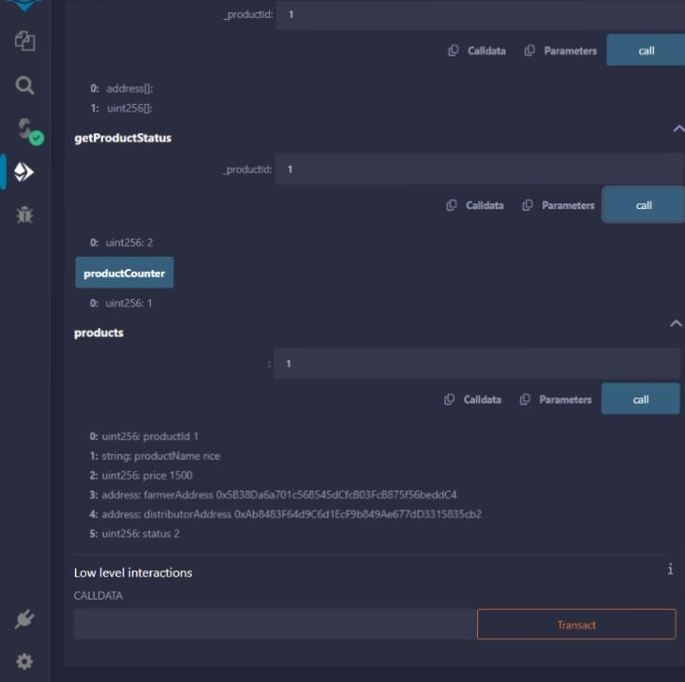

Slide 10
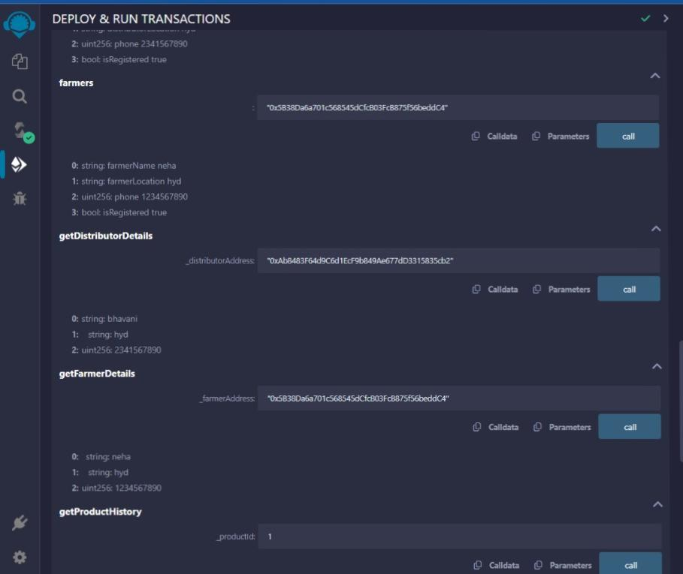

Slide 11
For next review
Implementation of frontend
Integration of frontend with Ethereum

Slide 12
FUTURE SCOPE
Integration of sensors, including IOT devices and imaging technology, into the blockchain system.
Capture images from the initial stages of crop cultivation to the harvest phase for a comprehensive visual record
Utilize sensors to monitor environmental conditions, soil health, and other relevant factors throughout the crop lifecycle.
Implement smart contracts using Solidity to automatically update the blockchain with real-time sensor data.
Enhance traceability and transparency by incorporating dynamic and accurate information about crop growth and conditions.
Enable data-driven decision-making for farmers, distributors, and other stakeholders based on real-time sensor data.
Strengthen the reliability of the agricultural supply chain management system with a holistic and technologically advanced approach.

Slide 13
Thank YOU

